Slide 1
Amplitude Modulation
Gaurav S. Kasbekar
Dept. of Electrical Engineering
IIT Bombay

Slide 2
Introduction
Information that needs to be transmitted over a communication channel usually a baseband signal
Recall: message signal shifted to a high-frequency band before transmission
“Carrier” is a sinusoid of high frequency
Modulation: process by which some characteristic of a carrier (e.g., amplitude, frequency, phase) varied in accordance with a modulating wave (message signal)
result of modulation referred to as “modulated wave”
Modulation performed at transmitter
At receiver, message (baseband) signal recovered using “demodulation”
We now study “amplitude modulation” (AM), in which amplitude of a carrier varied in accordance with message signal
Later, we will study frequency modulation (FM) and phase modulation (PM)

Slide 3
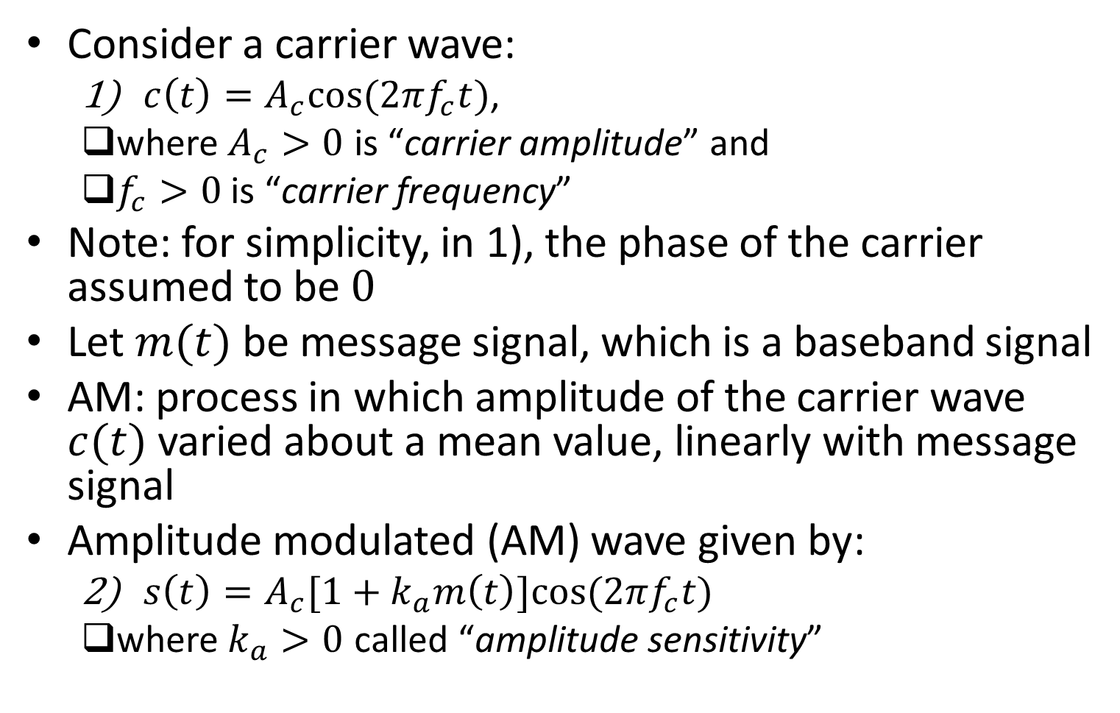
Amplitude Modulation (AM)
Consider a carrier wave:
$c\left(t\right)=A_{c}cos⁡(2πf_{c}t)$,
where $A_{c}>0$ is “carrier amplitude” and
$f_{c}>0$ is “carrier frequency”
Note: for simplicity, in 1), the phase of the carrier assumed to be $0$
Let $m(t)$ be message signal, which is a baseband signal
AM: process in which amplitude of the carrier wave $c(t)$ varied about a mean value, linearly with message signal
Amplitude modulated (AM) wave given by:
$s\left(t\right)=A_{c}[1+k_{a}m\left(t\right)]cos⁡(2πf_{c}t)$
where $k_{a}>0$ called “amplitude sensitivity”

Slide 4
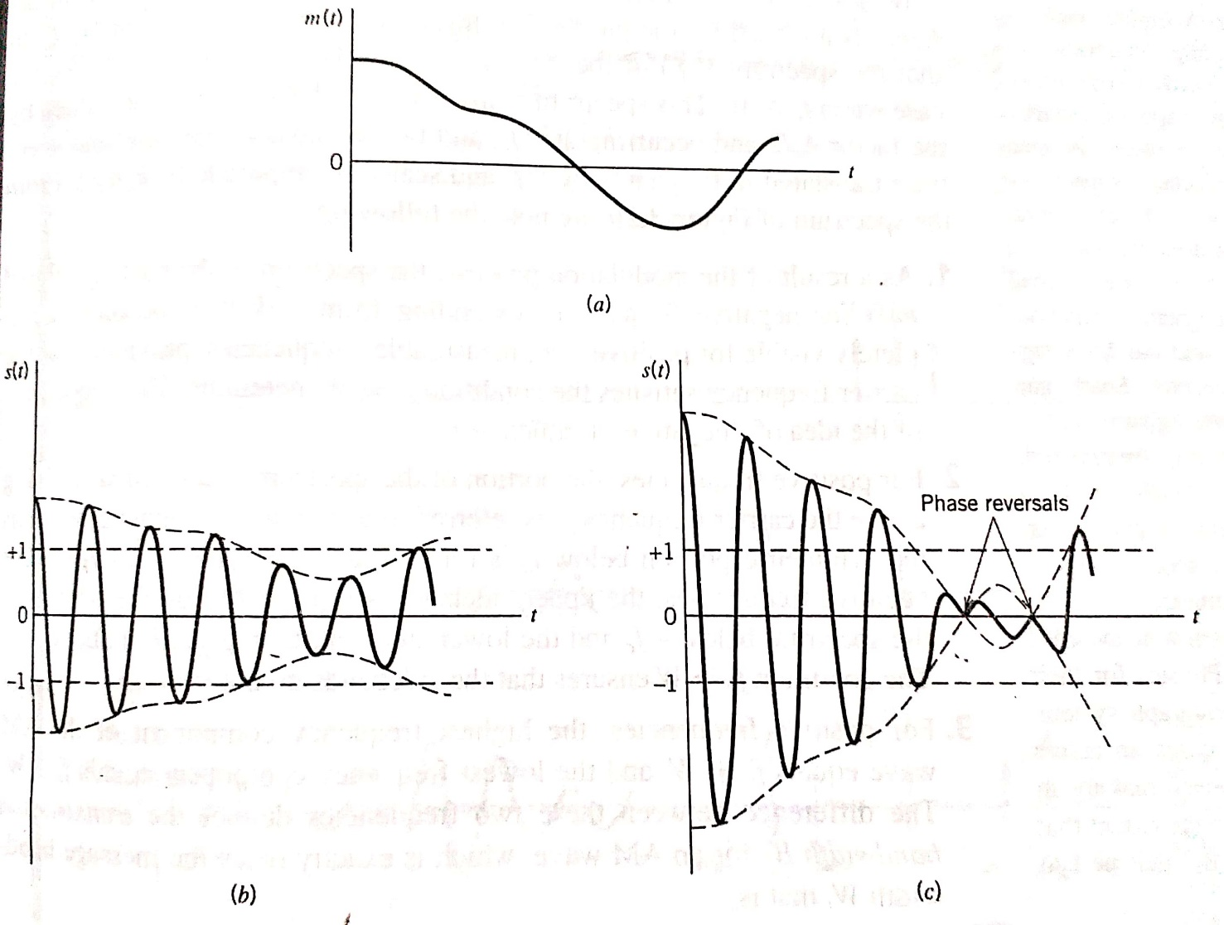
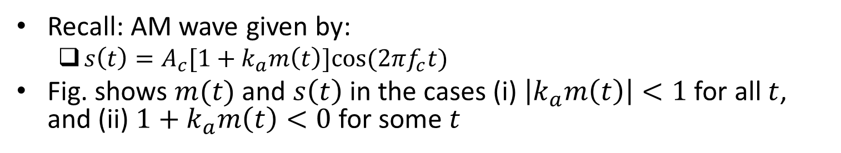
Example
Recall: AM wave given by:
$s\left(t\right)=A_{c}[1+k_{a}m\left(t\right)]cos⁡(2πf_{c}t)$
Fig. shows $m(t)$ and $s\left(t\right)$ in the cases (i) $\left|k_{a}m\left(t\right)\right|<1$ for all $t$, and (ii) $1+k_{a}m\left(t\right)<0$ for some $t$
Ref: “Communication Systems” by S. Haykin and M. Moher, 5th ed

Slide 5
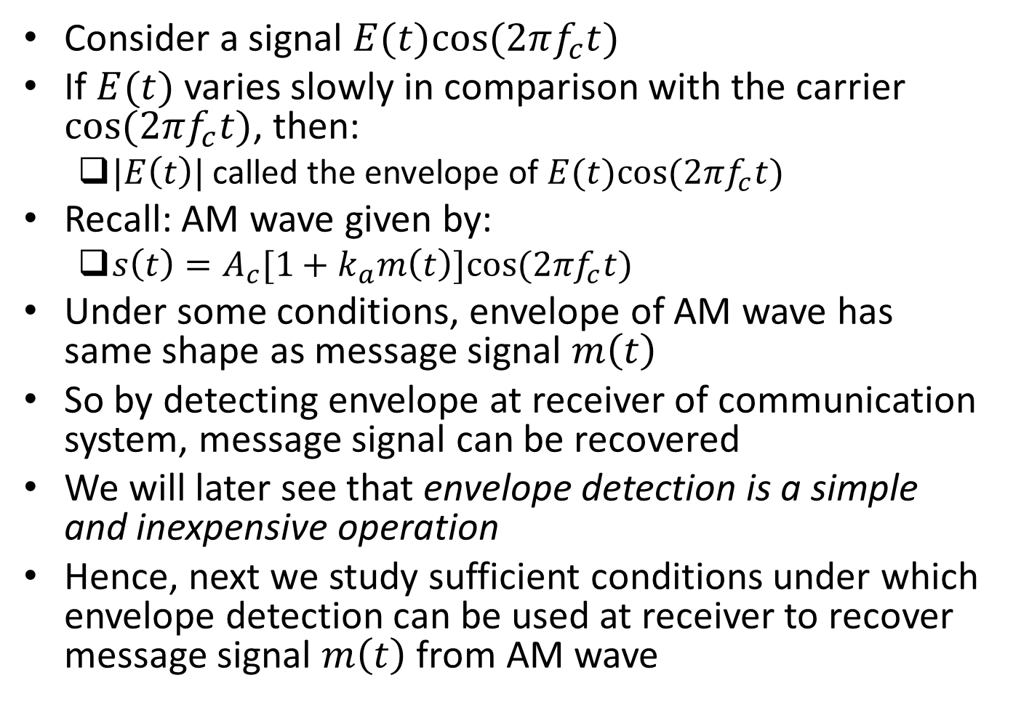
Envelope Detection
Consider a signal $E(t)cos⁡(2πf_{c}t)$
If $E(t)$ varies slowly in comparison with the carrier $cos⁡(2πf_{c}t)$, then:
$|E\left(t\right)|$ called the envelope of $E(t)cos⁡(2πf_{c}t)$
Recall: AM wave given by:
$s\left(t\right)=A_{c}[1+k_{a}m\left(t\right)]cos⁡(2πf_{c}t)$
Under some conditions, envelope of AM wave has same shape as message signal $m\left(t\right)$
So by detecting envelope at receiver of communication system, message signal can be recovered
We will later see that envelope detection is a simple and inexpensive operation
Hence, next we study sufficient conditions under which envelope detection can be used at receiver to recover message signal $m\left(t\right)$ from AM wave

Slide 6
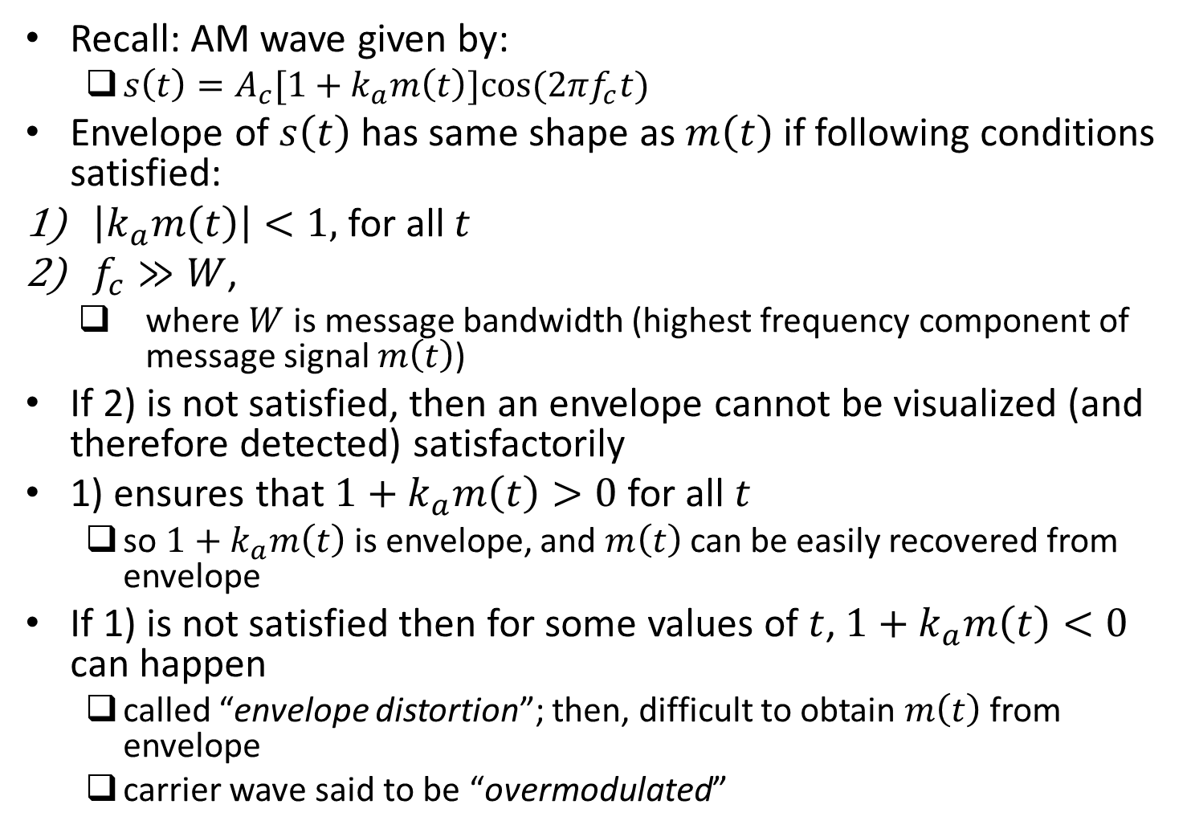
Envelope Detection (contd.)
Recall: AM wave given by:
$s\left(t\right)=A_{c}[1+k_{a}m\left(t\right)]cos⁡(2πf_{c}t)$
Envelope of $s\left(t\right)$ has same shape as $m\left(t\right)$ if following conditions satisfied:
$\left|k_{a}m\left(t\right)\right|<1,$ for all $t$
$f_{c}≫W$,
where $W$ is message bandwidth (highest frequency component of message signal $m\left(t\right)$)
If 2) is not satisfied, then an envelope cannot be visualized (and therefore detected) satisfactorily
1) ensures that $1+k_{a}m\left(t\right)>0$ for all $t$
so $1+k_{a}m\left(t\right)$ is envelope, and $m\left(t\right)$ can be easily recovered from envelope
If 1) is not satisfied then for some values of $t$, $1+k_{a}m\left(t\right)<0$ can happen
called “envelope distortion”; then, difficult to obtain $m\left(t\right)$ from envelope
carrier wave said to be “overmodulated”

Slide 7
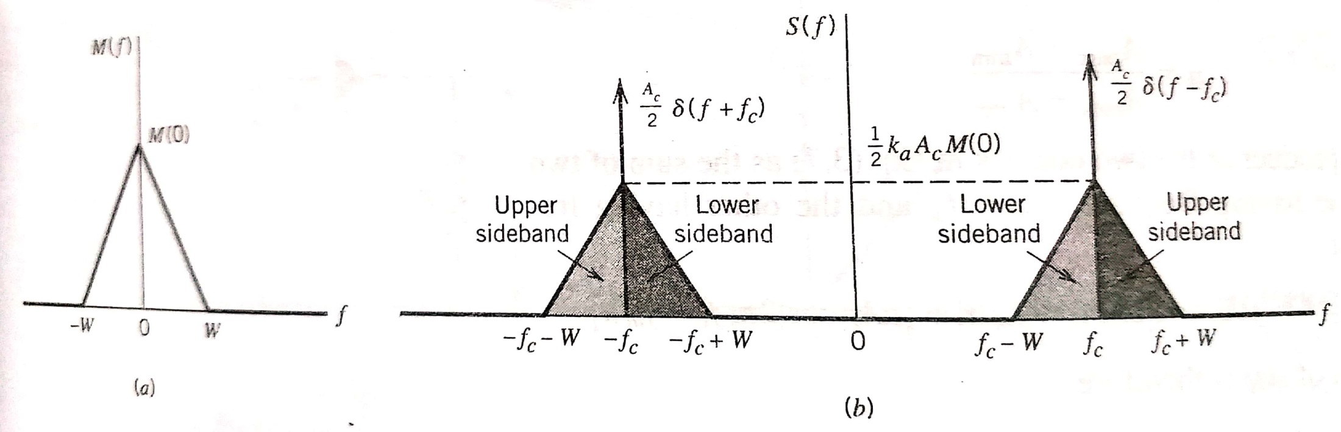
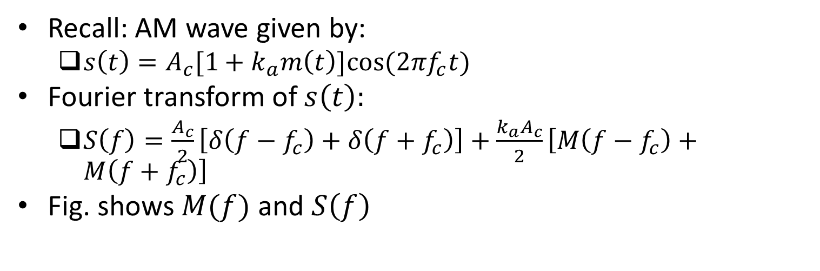
Spectrum of AM Wave
Recall: AM wave given by:
$s\left(t\right)=A_{c}[1+k_{a}m\left(t\right)]cos⁡(2πf_{c}t)$
Fourier transform of $s\left(t\right):$
$S\left(f\right)=\frac{A_{c}}{2}\left[δ\left(f−f_{c}\right)+δ\left(f+f_{c}\right)\right]+\frac{{k_{a}A}_{c}}{2}\left[M\left(f−f_{c}\right)+M\left(f+f_{c}\right)\right]$
Fig. shows $M(f)$ and $S\left(f\right)$
Ref: “Communication Systems” by S. Haykin and M. Moher, 5th ed

Slide 8

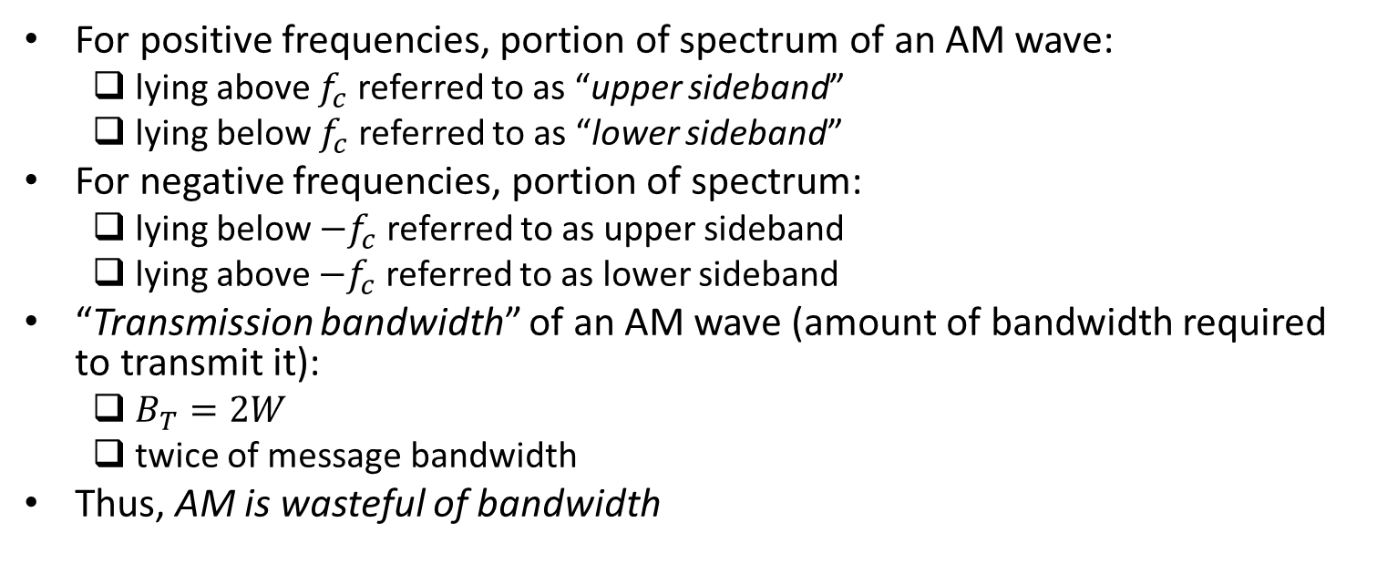
Spectrum of AM Wave (contd.)
For positive frequencies, portion of spectrum of an AM wave:
lying above $f_{c}$ referred to as “upper sideband”
lying below $f_{c}$ referred to as “lower sideband”
For negative frequencies, portion of spectrum:
lying below $−f_{c}$ referred to as upper sideband
lying above $−f_{c}$ referred to as lower sideband
“Transmission bandwidth” of an AM wave (amount of bandwidth required to transmit it):
$B_{T}=2W$
twice of message bandwidth
Thus, AM is wasteful of bandwidth
Ref: “Communication Systems” by S. Haykin and M. Moher, 5th ed

Slide 9
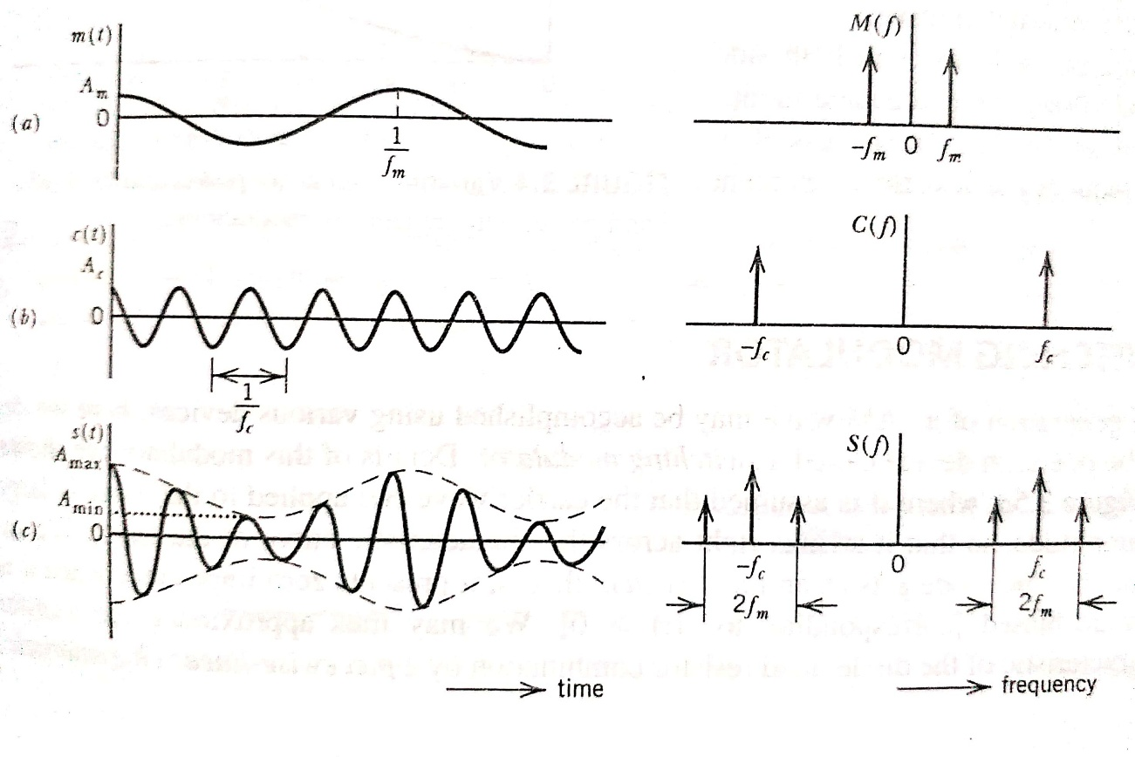
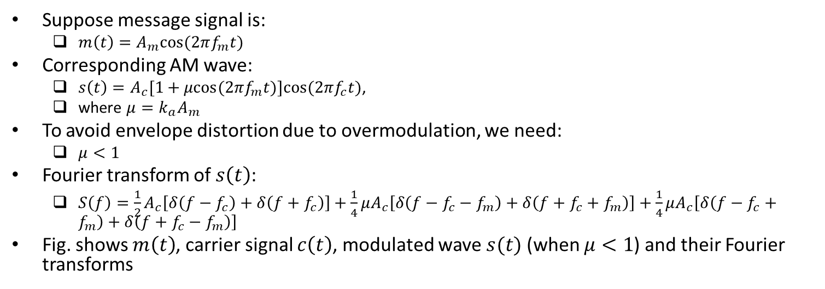
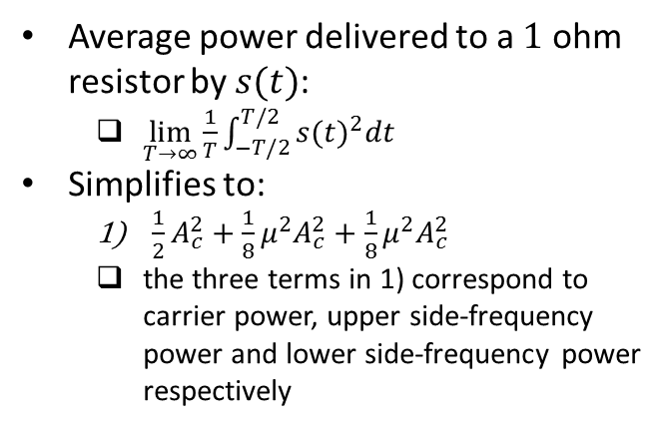
Example: Single-Tone Modulation
Suppose message signal is:
$m\left(t\right)=A_{m}cos⁡(2πf_{m}t)$
Corresponding AM wave:
$s\left(t\right)=A_{c}[1+μcos⁡(2πf_{m}t)]cos⁡(2πf_{c}t)$,
where $μ={k_{a}A}_{m}$
To avoid envelope distortion due to overmodulation, we need:
$μ<1$
Fourier transform of $s\left(t\right)$:
$S\left(f\right)=\frac{1}{2}A_{c}\left[δ\left(f−f_{c}\right)+δ\left(f+f_{c}\right)\right]+\frac{1}{4}μA_{c}\left[δ\left(f−f_{c}−f_{m}\right)+δ\left(f+f_{c}+f_{m}\right)\right]+\frac{1}{4}μA_{c}\left[δ\left(f−f_{c}+f_{m}\right)+δ\left(f+f_{c}−f_{m}\right)\right]$
Fig. shows $m\left(t\right)$, carrier signal $c\left(t\right)$, modulated wave $s(t)$ (when $μ<1$) and their Fourier transforms
Average power delivered to a $1$ ohm resistor by $s(t)$:
$\lim_{T→∞}\frac{1}{T}{\int_{−T/2}^{T/2}{{s(t)}^{2}dt}}$
Simplifies to:
$\frac{1}{2}A_{c}^{2}+\frac{1}{8}μ^{2}A_{c}^{2}+\frac{1}{8}μ^{2}A_{c}^{2}$
the three terms in 1) correspond to carrier power, upper side-frequency power and lower side-frequency power respectively
Ref: “Communication Systems” by S. Haykin and M. Moher, 5th ed

Slide 10
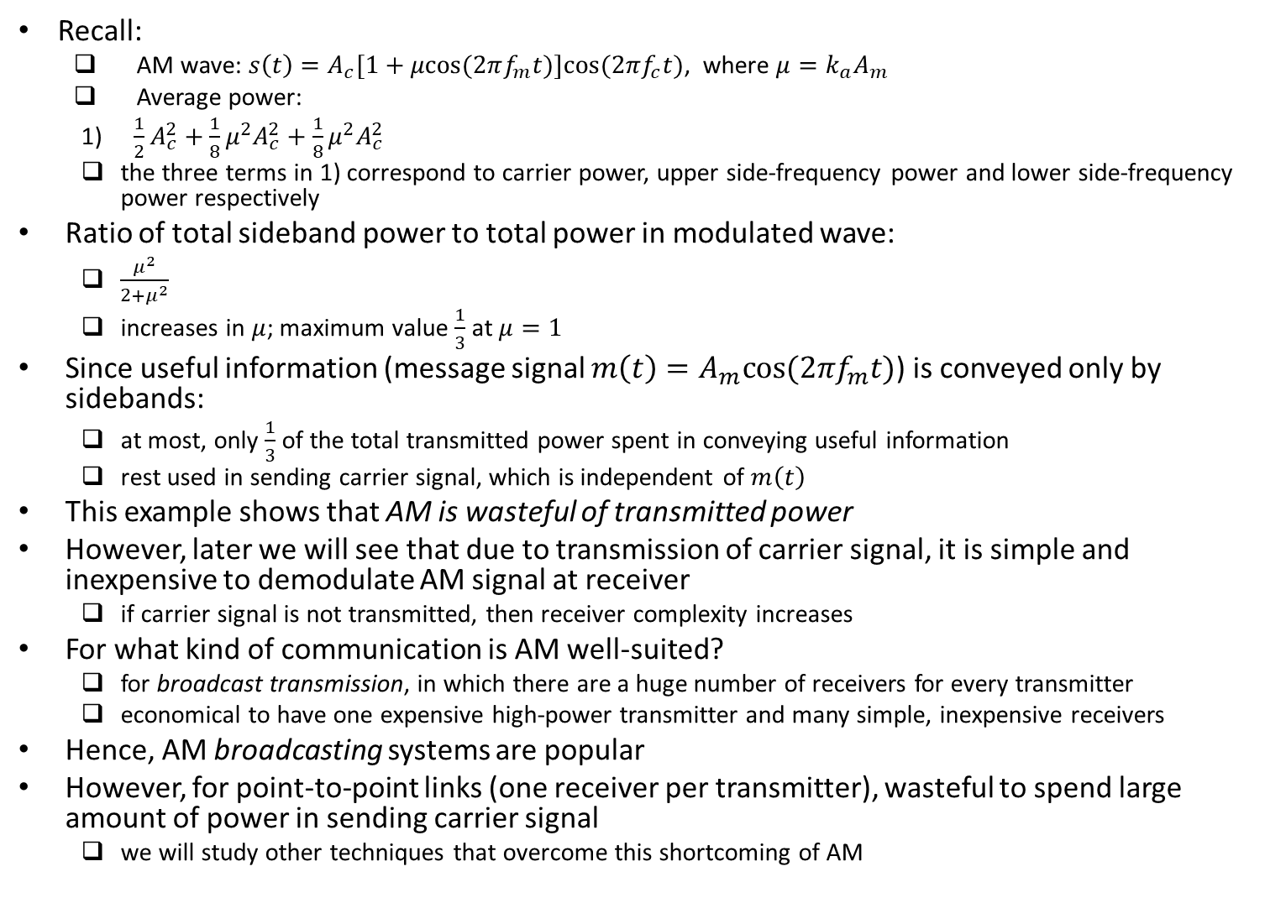
Example: Single-Tone Modulation (contd.)
Recall:
AM wave: $s\left(t\right)=A_{c}[1+μcos⁡(2πf_{m}t)]cos⁡(2πf_{c}t)$, where $μ={k_{a}A}_{m}$
Average power:
$\frac{1}{2}A_{c}^{2}+\frac{1}{8}μ^{2}A_{c}^{2}+\frac{1}{8}μ^{2}A_{c}^{2}$
the three terms in 1) correspond to carrier power, upper side-frequency power and lower side-frequency power respectively
Ratio of total sideband power to total power in modulated wave:
$\frac{μ^{2}}{2+μ^{2}}$
increases in $μ$; maximum value $\frac{1}{3}$ at $μ=1$
Since useful information (message signal $m\left(t\right)=A_{m}cos⁡(2πf_{m}t)$) is conveyed only by sidebands:
at most, only $\frac{1}{3}$ of the total transmitted power spent in conveying useful information
rest used in sending carrier signal, which is independent of $m\left(t\right)$
This example shows that AM is wasteful of transmitted power
However, later we will see that due to transmission of carrier signal, it is simple and inexpensive to demodulate AM signal at receiver
if carrier signal is not transmitted, then receiver complexity increases
For what kind of communication is AM well-suited?
for broadcast transmission, in which there are a huge number of receivers for every transmitter
economical to have one expensive high-power transmitter and many simple, inexpensive receivers
Hence, AM broadcasting systems are popular
However, for point-to-point links (one receiver per transmitter), wasteful to spend large amount of power in sending carrier signal
we will study other techniques that overcome this shortcoming of AM

Slide 11
Summary: Advantages and Disadvantages of AM; Alternatives
Advantages of AM:
Modulation and demodulation process simple
Inexpensive receivers can be used
Limitations of AM:
Wasteful of bandwidth since transmission bandwidth is twice of message bandwidth
Amplitude and phase spectra of upper and lower sidebands are symmetrical about carrier frequency
Sufficient to transmit only one sideband to convey all information contained in message signal; but AM transmits both sidebands
Wasteful of transmitter power since large amount of power spent in transmitting carrier signal, which is independent of message signal
Next, we will study some alternative modulation/ demodulation techniques:
more efficient in terms of transmission bandwidth and/ or transmitter power
but modulation and/ or demodulation process more complex
Alternative modulation/ demodulation techniques:
Double Sideband-Suppressed Carrier (DSB-SC) Modulation
Vestigial Sideband (VSB) Modulation
Single Sideband (SSB) Modulation

Slide 12
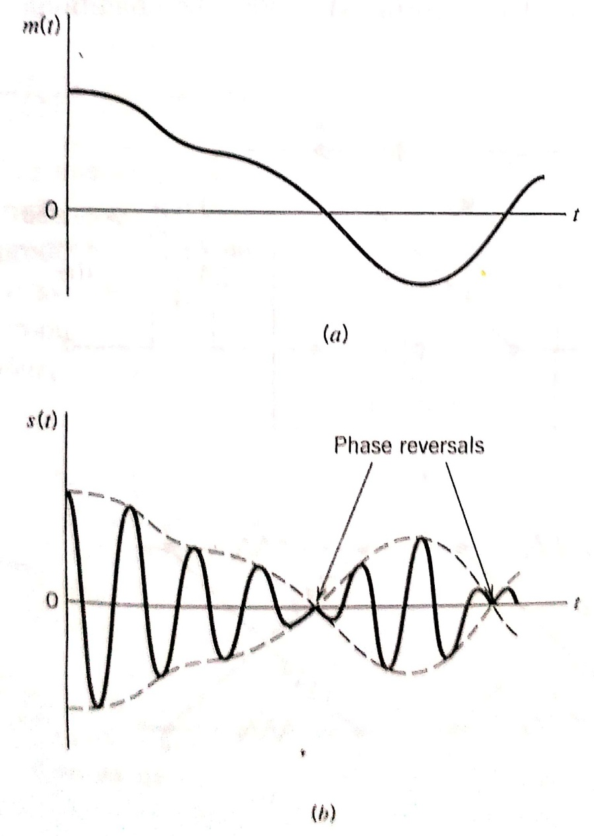
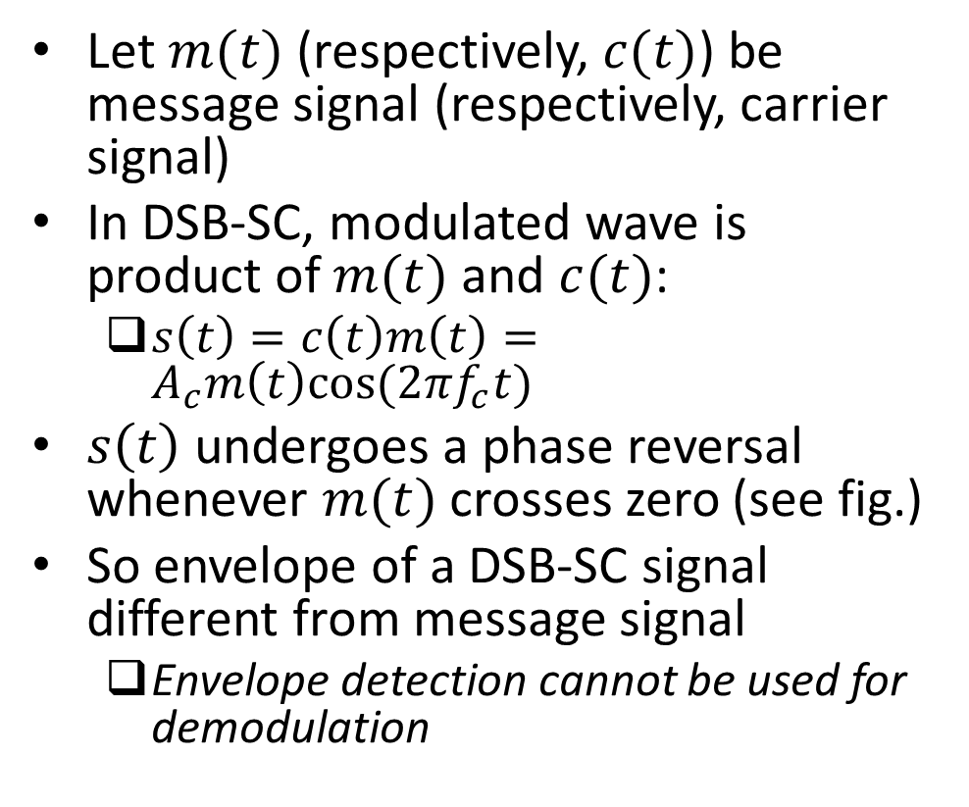
Double Sideband-Suppressed Carrier (DSB-SC) Modulation
Let $m(t)$ (respectively, $c(t)$) be message signal (respectively, carrier signal)
In DSB-SC, modulated wave is product of $m(t)$ and $c(t)$:
$s\left(t\right)=c\left(t\right)m\left(t\right)=A_{c}m\left(t\right)cos⁡(2πf_{c}t)$
$s\left(t\right)$ undergoes a phase reversal whenever $m(t)$ crosses zero (see fig.)
So envelope of a DSB-SC signal different from message signal
Envelope detection cannot be used for demodulation
Ref: “Communication Systems” by S. Haykin and M. Moher, 5th ed

Slide 13
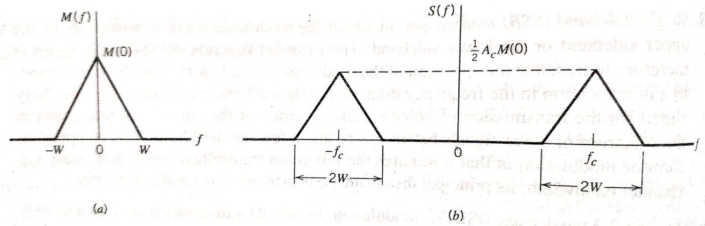
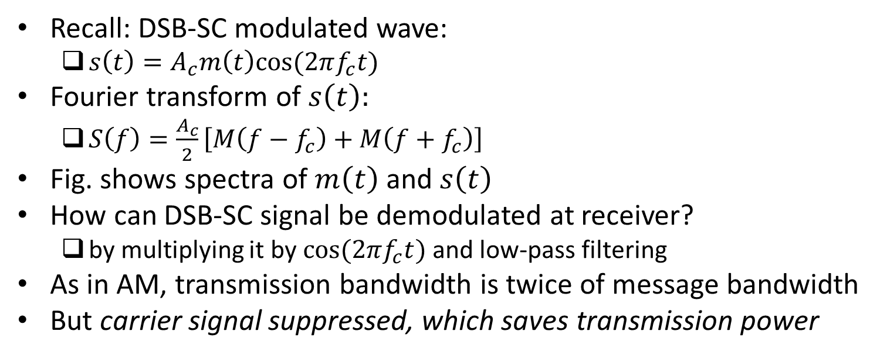
DSB-SC Modulation (contd.)
Recall: DSB-SC modulated wave:
$s\left(t\right)=A_{c}m\left(t\right)cos⁡(2πf_{c}t)$
Fourier transform of $s\left(t\right):$
$S\left(f\right)=\frac{A_{c}}{2}\left[M\left(f−f_{c}\right)+M\left(f+f_{c}\right)\right]$
Fig. shows spectra of $m\left(t\right)$ and $s\left(t\right)$
How can DSB-SC signal be demodulated at receiver?
by multiplying it by $cos⁡(2πf_{c}t)$ and low-pass filtering
As in AM, transmission bandwidth is twice of message bandwidth
But carrier signal suppressed, which saves transmission power
Ref: “Communication Systems” by S. Haykin and M. Moher, 5th ed

Slide 14
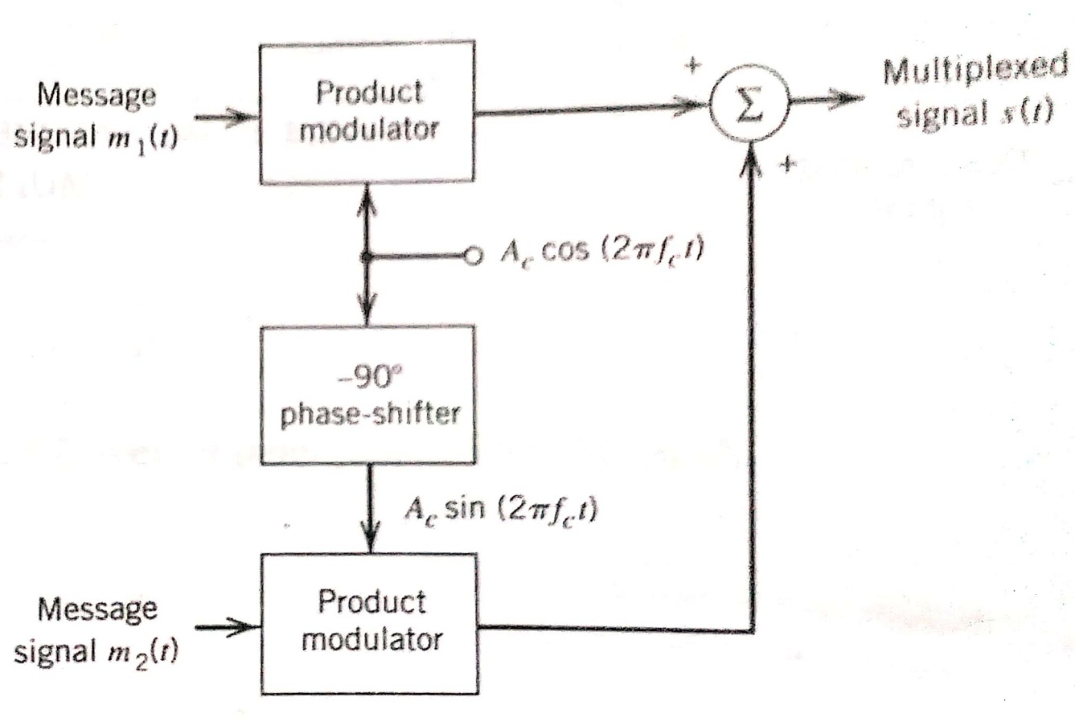
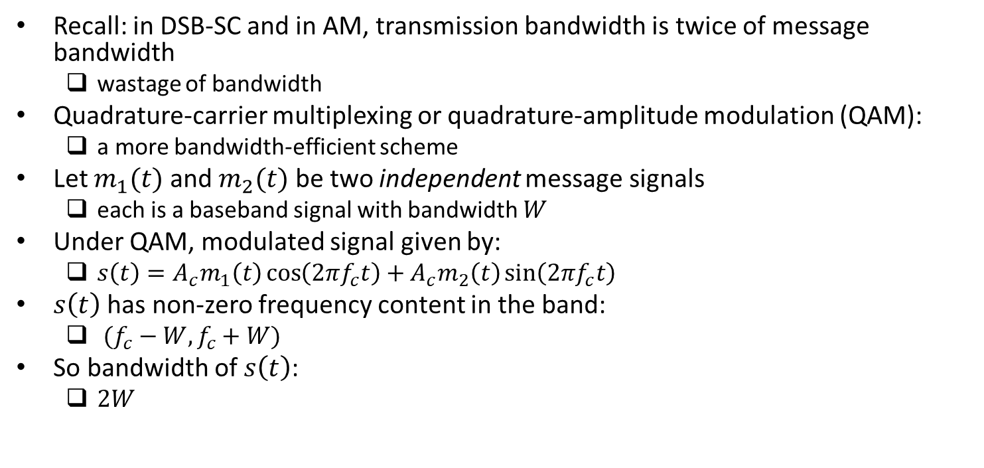
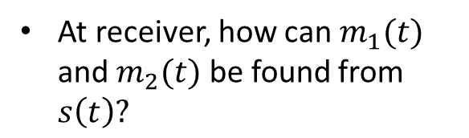
Quadrature-Carrier Multiplexing
Recall: in DSB-SC and in AM, transmission bandwidth is twice of message bandwidth
wastage of bandwidth
Quadrature-carrier multiplexing or quadrature-amplitude modulation (QAM):
a more bandwidth-efficient scheme
Let $m_{1}(t)$ and $m_{2}(t)$ be two independent message signals
each is a baseband signal with bandwidth $W$
Under QAM, modulated signal given by:
$s\left(t\right)=A_{c}m_{1}\left(t\right)\cos\left(2πf_{c}t\right)+A_{c}m_{2}\left(t\right)\sin\left(2πf_{c}t\right)$
$s\left(t\right)$ has non-zero frequency content in the band:
$(f_{c}−W,f_{c}+W)$
So bandwidth of $s\left(t\right)$:
$2W$
At receiver, how can $m_{1}(t)$ and $m_{2}(t)$ be found from $s\left(t\right)?$
Ref: “Communication Systems” by S. Haykin and M. Moher, 5th ed

Slide 15
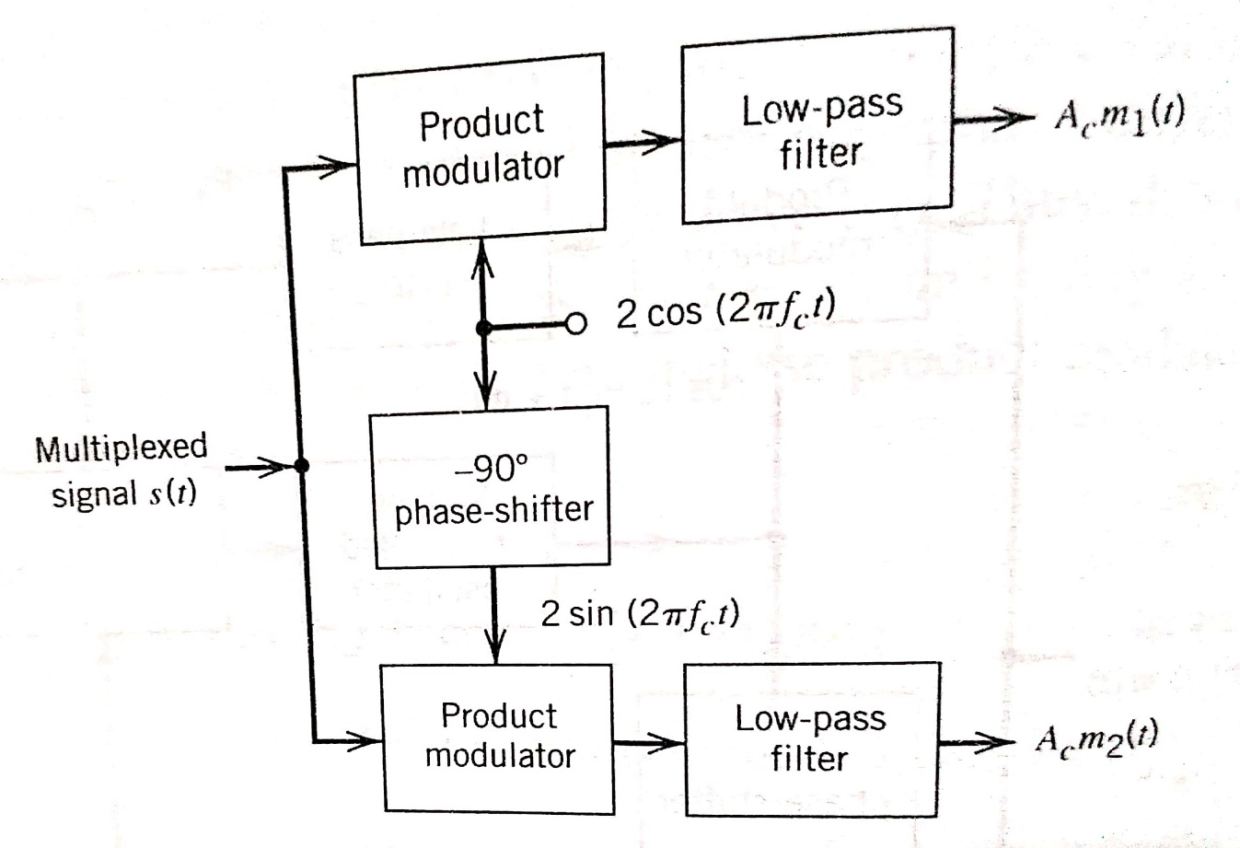
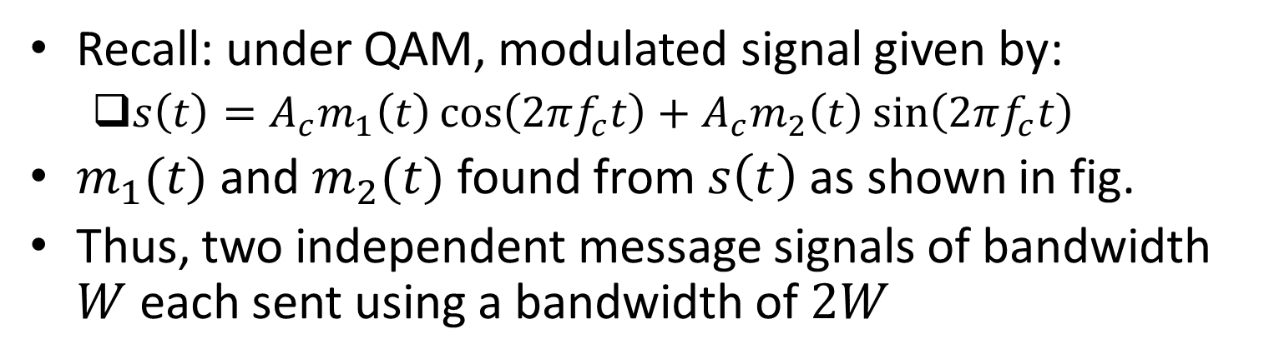
Quadrature-Carrier Multiplexing (contd.)
Recall: under QAM, modulated signal given by:
$s\left(t\right)=A_{c}m_{1}\left(t\right)\cos\left(2πf_{c}t\right)+A_{c}m_{2}\left(t\right)\sin\left(2πf_{c}t\right)$
$m_{1}(t)$ and $m_{2}(t)$ found from $s\left(t\right)$ as shown in fig.
Thus, two independent message signals of bandwidth $W$ each sent using a bandwidth of $2W$
Twice as bandwidth-efficient as AM or DSB-SC
Ref: “Communication Systems” by S. Haykin and M. Moher, 5th ed

Slide 16
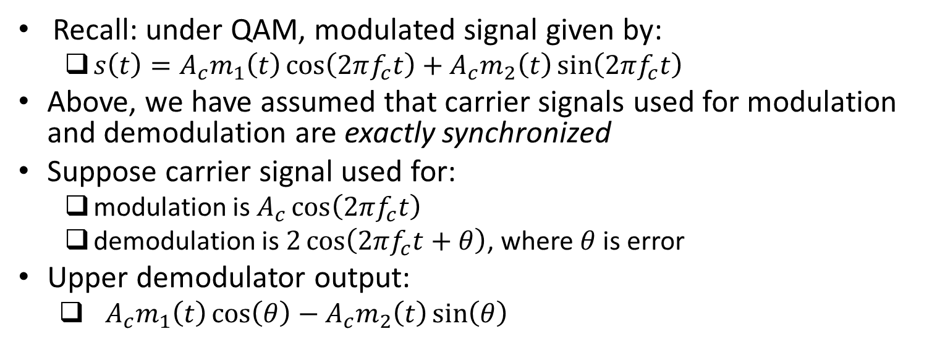
Quadrature-Carrier Multiplexing (contd.)
Recall: under QAM, modulated signal given by:
$s\left(t\right)=A_{c}m_{1}\left(t\right)\cos\left(2πf_{c}t\right)+A_{c}m_{2}\left(t\right)\sin\left(2πf_{c}t\right)$
Above, we have assumed that carrier signals used for modulation and demodulation are exactly synchronized
Suppose carrier signal used for:
modulation is $A_{c}\cos\left(2πf_{c}t\right)$
demodulation is $2\cos\left(2πf_{c}t+θ\right)$, where $θ$ is error
Upper demodulator output:
$A_{c}m_{1}\left(t\right)\cos\left(θ\right)−{A_{c}m}_{2}\left(t\right)\sin\left(θ\right)$
Called co-channel interference
Exercise: Find lower demodulator output and show that co-channel interference occurs for it as well
Ref: “Communication Systems” by S. Haykin and M. Moher, 5th ed

Slide 17
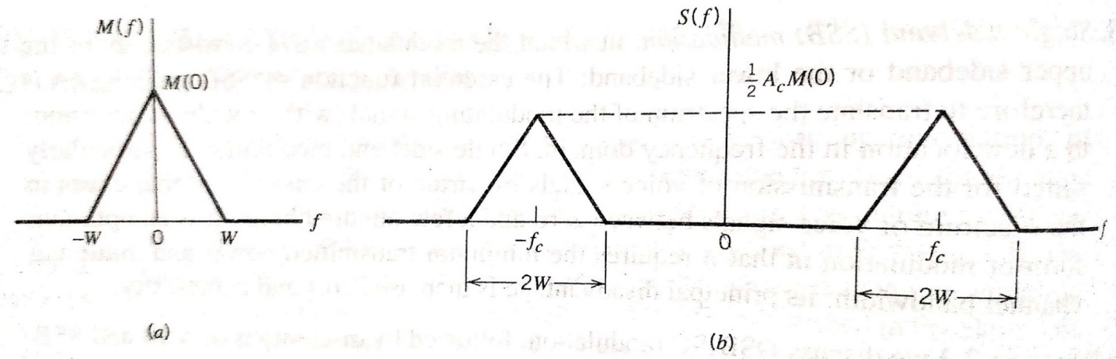
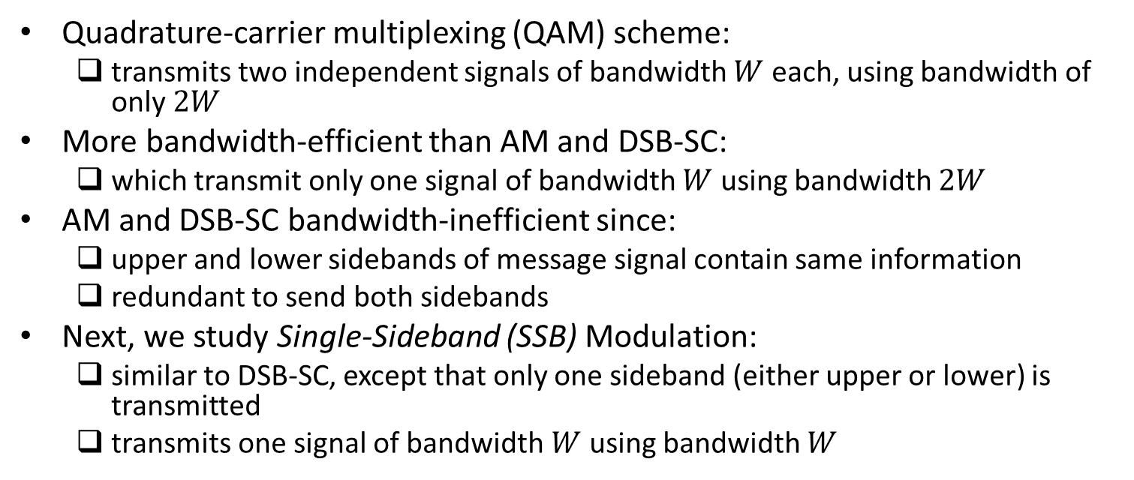
Bandwidth Conservation
Quadrature-carrier multiplexing (QAM) scheme:
transmits two independent signals of bandwidth $W$ each, using bandwidth of only $2W$
More bandwidth-efficient than AM and DSB-SC:
which transmit only one signal of bandwidth $W$ using bandwidth $2W$
AM and DSB-SC bandwidth-inefficient since:
upper and lower sidebands of message signal contain same information
redundant to send both sidebands
Next, we study Single-Sideband (SSB) Modulation:
similar to DSB-SC, except that only one sideband (either upper or lower) is transmitted
transmits one signal of bandwidth $W$ using bandwidth $W$
Ref: “Communication Systems” by S. Haykin and M. Moher, 5th ed

Slide 18
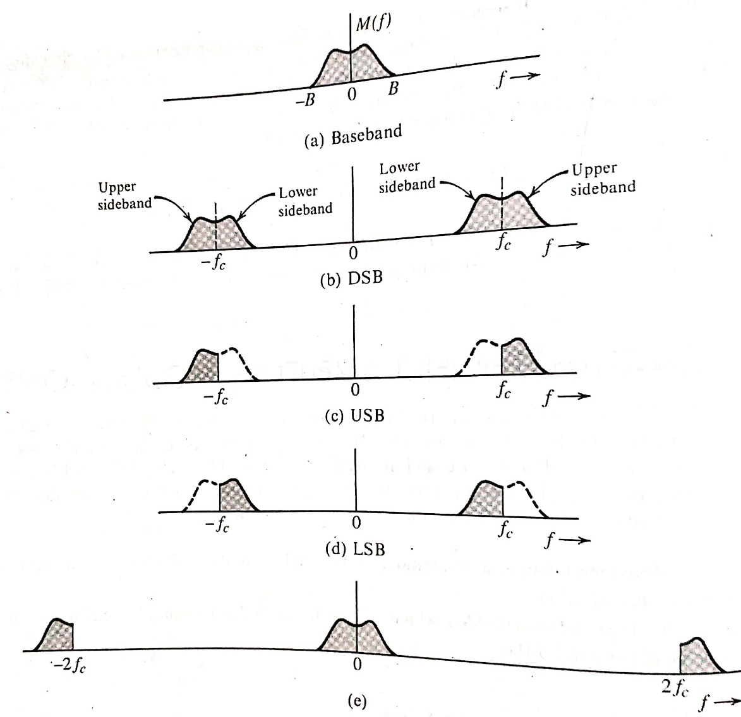
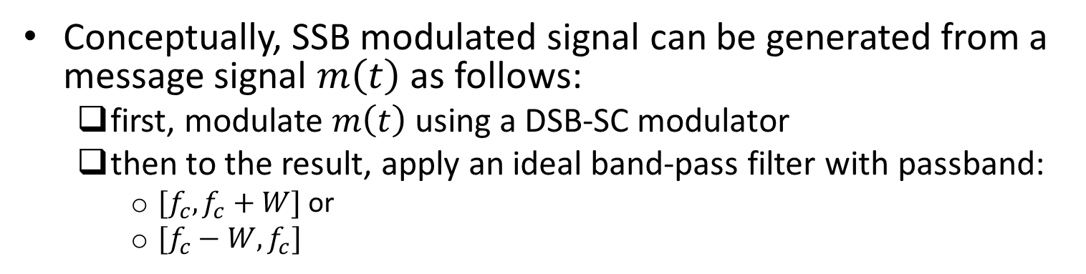
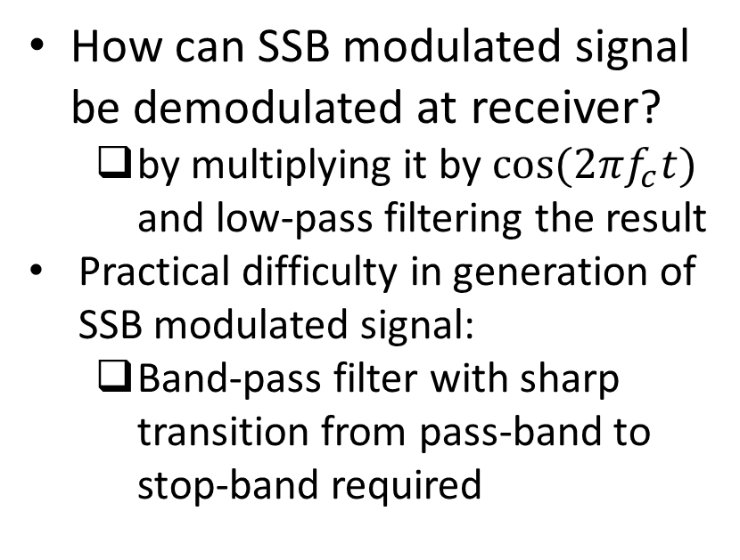
Single-Sideband (SSB) Modulation
Conceptually, SSB modulated signal can be generated from a message signal $m\left(t\right)$ as follows:
first, modulate $m\left(t\right)$ using a DSB-SC modulator
then to the result, apply an ideal band-pass filter with passband:
$[f_{c},f_{c}+W]$ or
$[f_{c}−W,f_{c}]$
How can SSB modulated signal be demodulated at receiver?
by multiplying it by $cos⁡(2πf_{c}t)$ and low-pass filtering the result
Practical difficulty in generation of SSB modulated signal:
Band-pass filter with sharp transition from pass-band to stop-band required
Ref: B.P. Lathi, Z. Ding, “Modern Digital and Analog Communication Systems”, 4th ed.

Slide 19
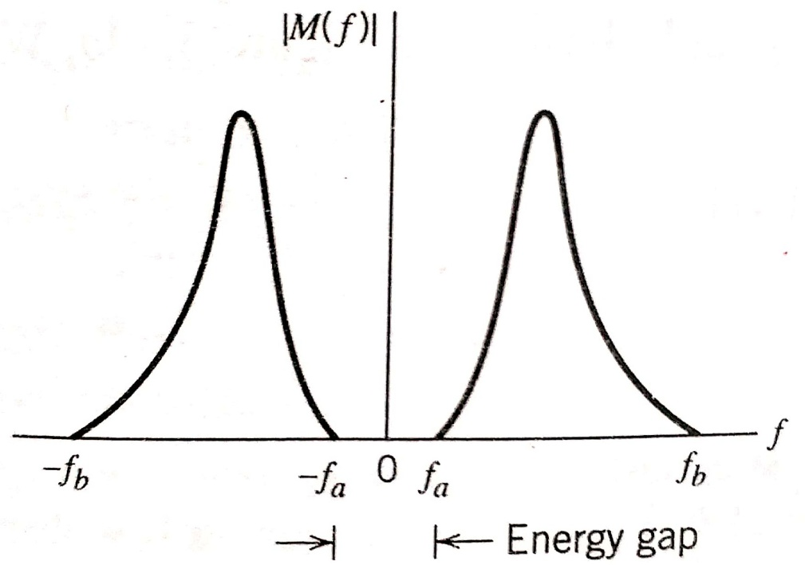
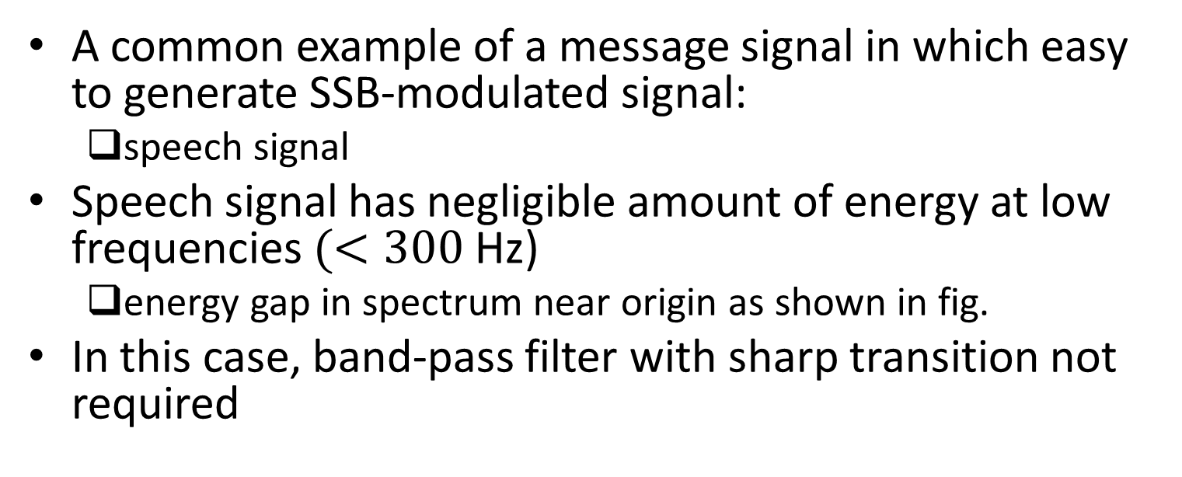
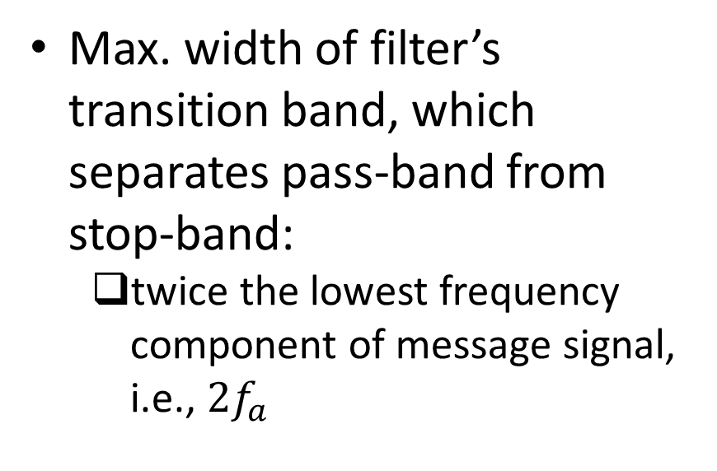
Single-Sideband (SSB) Modulation (contd.)
A common example of a message signal in which easy to generate SSB-modulated signal:
speech signal
Speech signal has negligible amount of energy at low frequencies $(<300$ Hz)
energy gap in spectrum near origin as shown in fig.
In this case, band-pass filter with sharp transition not required
Max. width of filter’s transition band, which separates pass-band from stop-band:
twice the lowest frequency component of message signal, i.e., $2f_{a}$
Ref: “Communication Systems” by S. Haykin and M. Moher, 5th ed

Slide 20
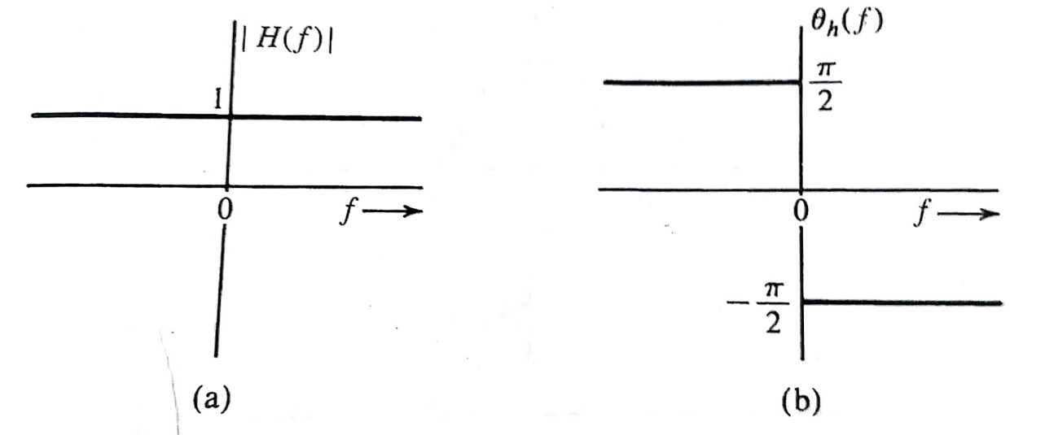
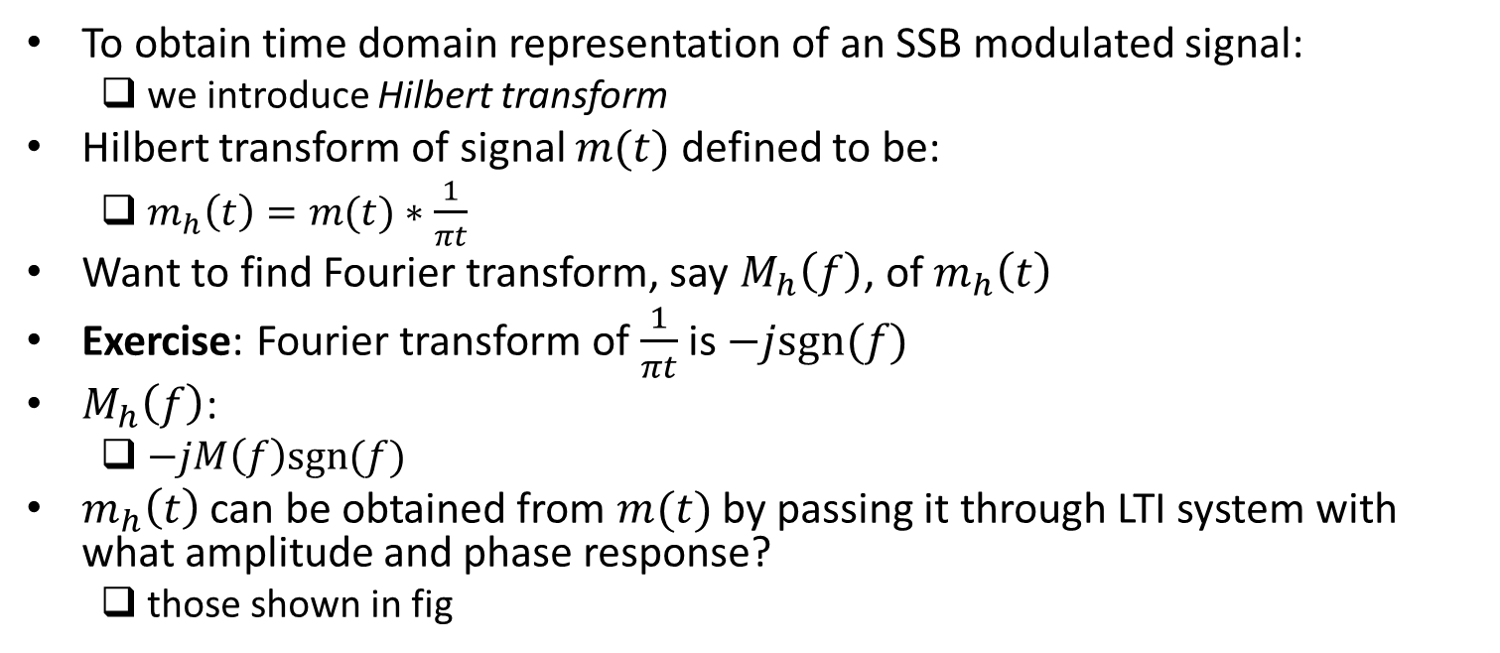
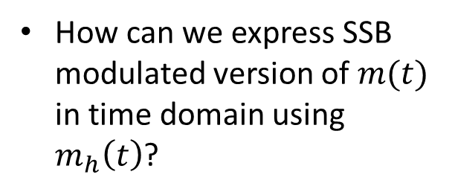
Time Domain Representation of SSB Modulated Signal
To obtain time domain representation of an SSB modulated signal:
we introduce Hilbert transform
Hilbert transform of signal $m(t)$ defined to be:
$m_{h}\left(t\right)=m(t)∗\frac{1}{πt}$
Want to find Fourier transform, say $M_{h}\left(f\right)$, of $m_{h}\left(t\right)$
Exercise: Fourier transform of $\frac{1}{πt}$ is $−jsgn(f)$
$M_{h}\left(f\right)$:
$−jM\left(f\right)sgn(f)$
$m_{h}\left(t\right)$ can be obtained from $m(t)$ by passing it through LTI system with what amplitude and phase response?
those shown in fig
How can we express SSB modulated version of $m(t)$ in time domain using $m_{h}\left(t\right)$?
Ref: B.P. Lathi, Z. Ding, “Modern Digital and Analog Communication Systems”, 4th ed.

Slide 21
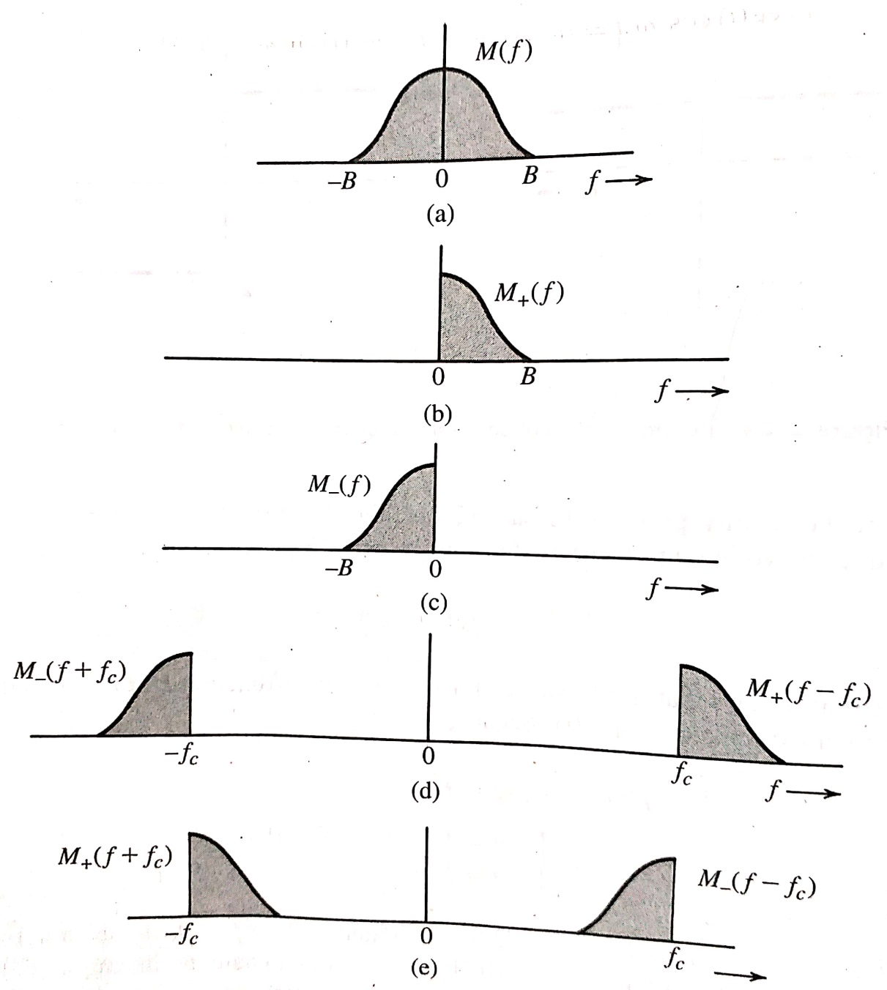
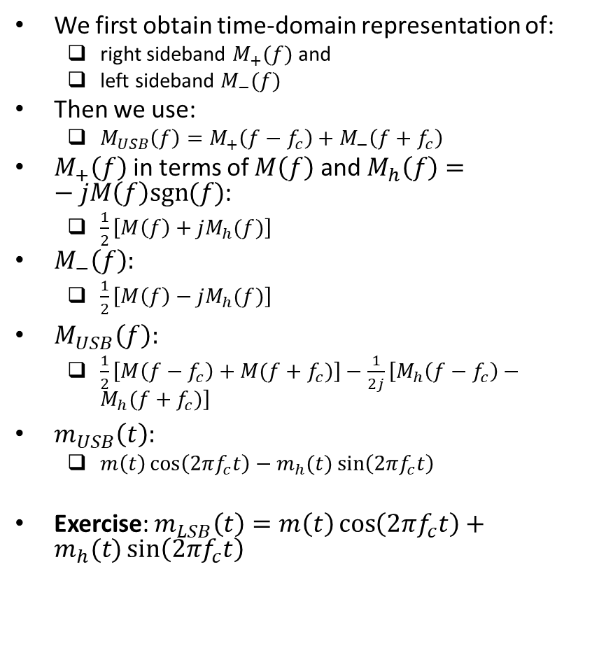
Time Domain Representation of SSB Modulated Signal (contd.)
We first obtain time-domain representation of:
right sideband $M_{+}(f)$ and
left sideband $M_{−}(f)$
Then we use:
$M_{USB}\left(f\right)=M_{+}\left(f−f_{c}\right)+M_{−}\left(f+f_{c}\right)$
$M_{+}\left(f\right)$ in terms of $M\left(f\right)$ and $M_{h}\left(f\right)=−jM\left(f\right)sgn(f)$:
$\frac{1}{2}\left[M\left(f\right)+jM_{h}(f)\right]$
$M_{−}\left(f\right):$
$\frac{1}{2}\left[M\left(f\right)−jM_{h}(f)\right]$
$M_{USB}\left(f\right):$
$\frac{1}{2}\left[M\left(f−f_{c}\right)+M(f+f_{c})\right]−\frac{1}{2j}\left[M_{h}\left(f−f_{c}\right)−M_{h}(f+f_{c})\right]$
$m_{USB}\left(t\right):$
$m\left(t\right)\cos\left(2πf_{c}t\right)−m_{h}(t)\sin\left(2πf_{c}t\right)$
Exercise: $m_{LSB}\left(t\right)=m\left(t\right)\cos\left(2πf_{c}t\right)+m_{h}(t)\sin\left(2πf_{c}t\right)$
Ref: B.P. Lathi, Z. Ding, “Modern Digital and Analog Communication Systems”, 4th ed.

Slide 22
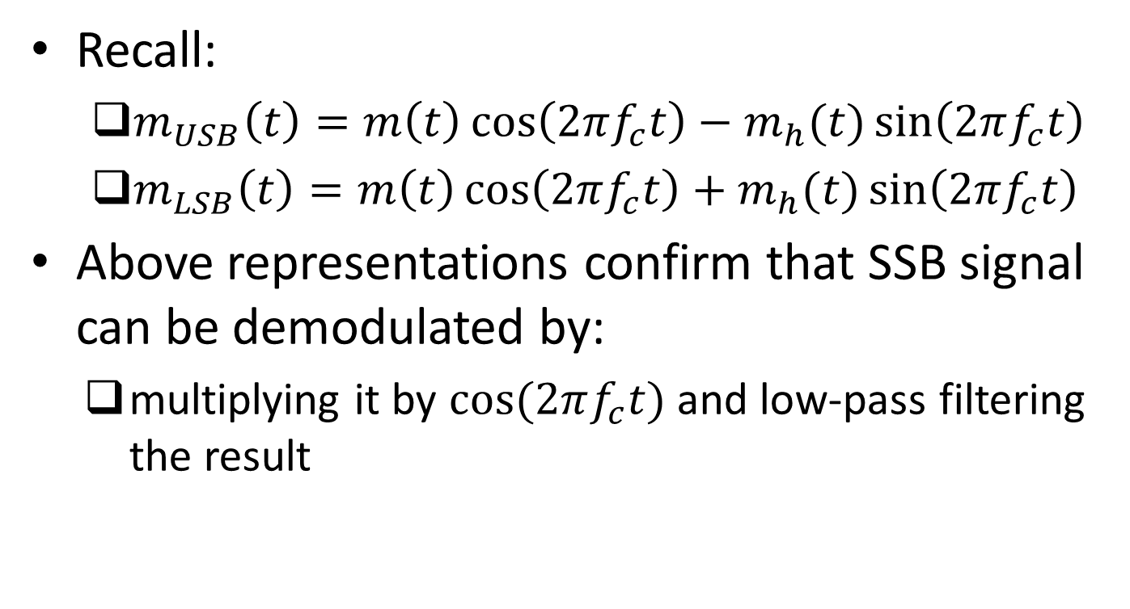
Demodulation of SSB Modulated Signal
Recall:
$m_{USB}\left(t\right)=m\left(t\right)\cos\left(2πf_{c}t\right)−m_{h}(t)\sin\left(2πf_{c}t\right)$
$m_{LSB}\left(t\right)=m\left(t\right)\cos\left(2πf_{c}t\right)+m_{h}(t)\sin\left(2πf_{c}t\right)$
Above representations confirm that SSB signal can be demodulated by:
multiplying it by $cos⁡(2πf_{c}t)$ and low-pass filtering the result

Slide 23
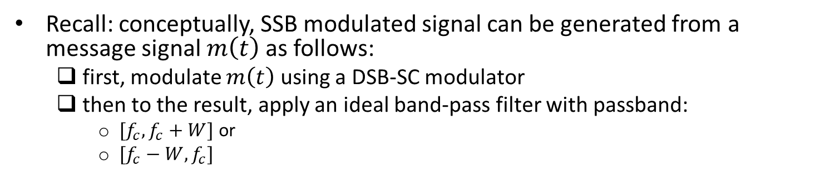
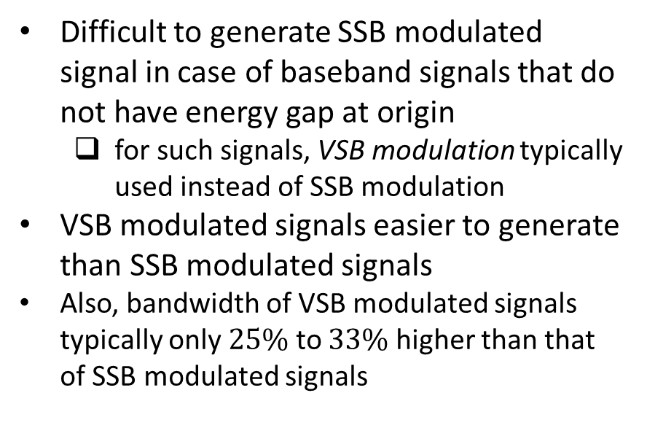
Vestigial-Sideband (VSB) Modulation
Recall: conceptually, SSB modulated signal can be generated from a message signal $m\left(t\right)$ as follows:
first, modulate $m\left(t\right)$ using a DSB-SC modulator
then to the result, apply an ideal band-pass filter with passband:
$[f_{c},f_{c}+W]$ or
$[f_{c}−W,f_{c}]$
Difficult to generate SSB modulated signal in case of baseband signals that do not have energy gap at origin
for such signals, VSB modulation typically used instead of SSB modulation
VSB modulated signals easier to generate than SSB modulated signals
Also, bandwidth of VSB modulated signals typically only $25\%$ to $33\%$ higher than that of SSB modulated signals
Ref: B.P. Lathi, Z. Ding, “Modern Digital and Analog Communication Systems”, 4th ed.

Slide 24
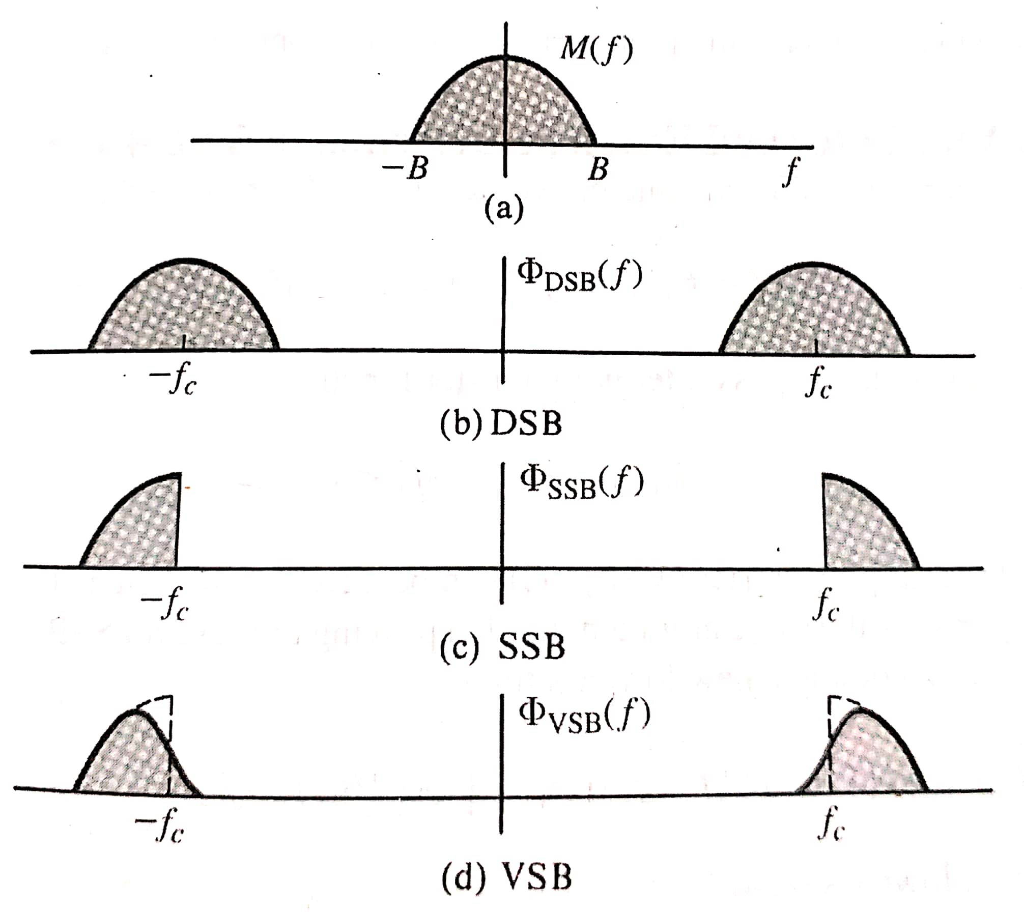
VSB Modulation (contd.)
Under VSB modulation:
all of one sideband is transmitted (with some distortion)
a small amount (vestige) of other sideband transmitted as well
Fig. shows VSB modulated signal
Ref: B.P. Lathi, Z. Ding, “Modern Digital and Analog Communication Systems”, 4th ed.

Slide 25
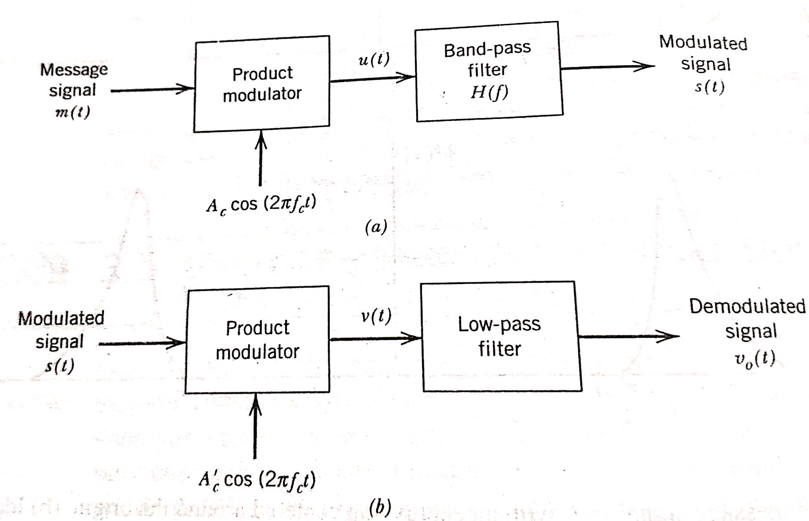
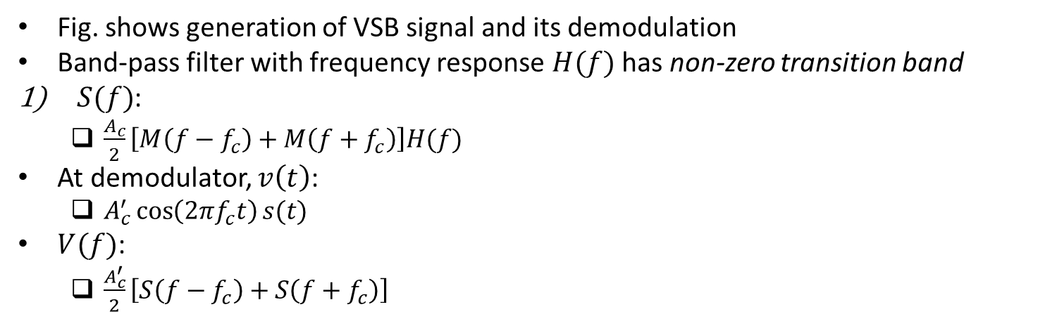
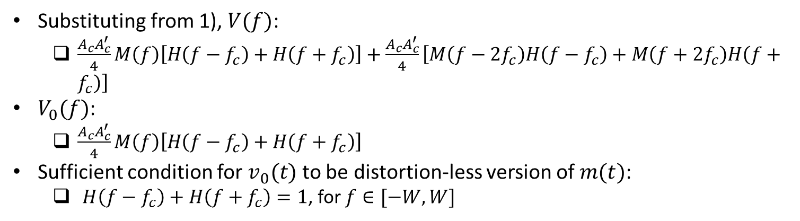
VSB Modulation (contd.)
Fig. shows generation of VSB signal and its demodulation
Band-pass filter with frequency response $H(f)$ has non-zero transition band
$S(f)$:
$\frac{A_{c}}{2}\left[M\left(f−f_{c}\right)+M\left(f+f_{c}\right)\right]H(f)$
At demodulator, $v\left(t\right)$:
$A_{c}^{′}\cos\left(2πf_{c}t\right)s(t)$
$V(f)$:
$\frac{A_{c}^{′}}{2}\left[S\left(f−f_{c}\right)+S\left(f+f_{c}\right)\right]$
Substituting from 1), $V(f)$:
$\frac{{A_{c}A}_{c}^{′}}{4}M\left(f\right)\left[H\left(f−f_{c}\right)+H\left(f+f_{c}\right)\right]+\frac{{A_{c}A}_{c}^{′}}{4}\left[M\left(f−2f_{c}\right)H\left(f−f_{c}\right)+M\left(f+2f_{c}\right)H\left(f+f_{c}\right)\right]$
$V_{0}(f)$:
$\frac{{A_{c}A}_{c}^{′}}{4}M\left(f\right)\left[H\left(f−f_{c}\right)+H\left(f+f_{c}\right)\right]$
Sufficient condition for $v_{0}(t)$ to be distortion-less version of $m(t)$:
$H\left(f−f_{c}\right)+H\left(f+f_{c}\right)=1$, for $f∈[−W,W]$
Ref: “Communication Systems” by S. Haykin and M. Moher, 5th ed

Slide 26
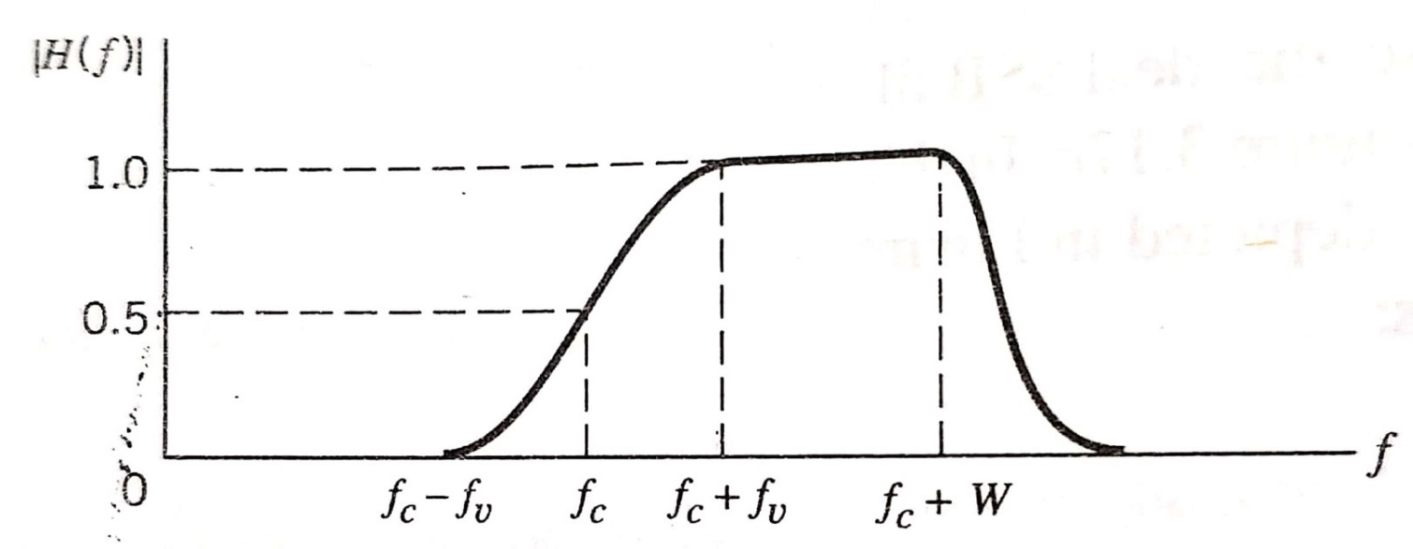
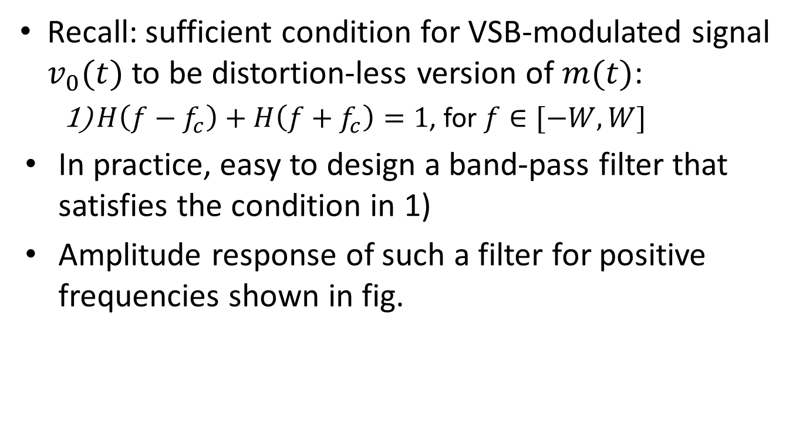
VSB Modulation (contd.)
Recall: sufficient condition for VSB-modulated signal $v_{0}(t)$ to be distortion-less version of $m(t)$:
$H\left(f−f_{c}\right)+H\left(f+f_{c}\right)=1$, for $f∈[−W,W]$
In practice, easy to design a band-pass filter that satisfies the condition in 1)
Amplitude response of such a filter for positive frequencies shown in fig.
Ref: “Communication Systems” by S. Haykin and M. Moher, 5th ed

Slide 27
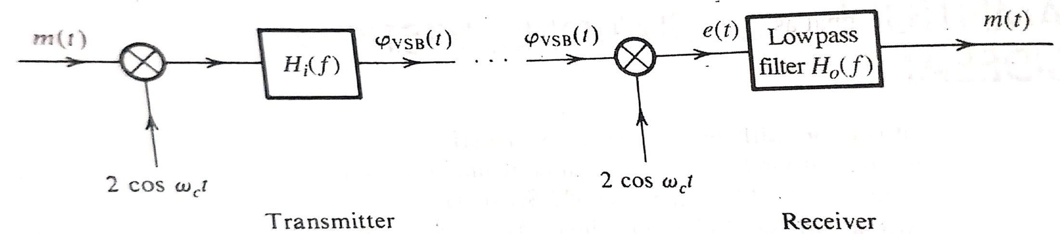
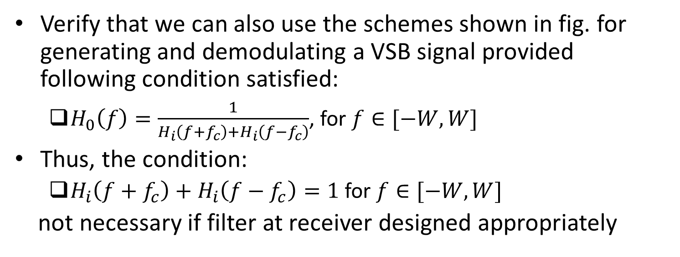
Exercise
Verify that we can also use the schemes shown in fig. for generating and demodulating a VSB signal provided following condition satisfied:
$H_{0}\left(f\right)=\frac{1}{H_{i}\left(f+f_{c}\right)+H_{i}\left(f−f_{c}\right)}$, for $f∈[−W,W]$
Thus, the condition:
$H_{i}\left(f+f_{c}\right)+H_{i}\left(f−f_{c}\right)=1$ for $f∈[−W,W]$
not necessary if filter at receiver designed appropriately
Ref: B.P. Lathi, Z. Ding, “Modern Digital and Analog Communication Systems”, 4th ed.

